Slide 1
Housing Issues and COVID-19
Judith Fox, Clinical Professor (jfox@nd.edu)
Notre Dame Law School

Slide 2
Housing in crisis
Notes:
We are on the verge of a housing crisis here in the US and I suspect other parts of the world. The COVID crisis did not create the problem, but it has certainly shown a light on weaknesses in our social safety net.
We are on the verge of both foreclosure and eviction numbers that are being described with word like unprecedented, tsunami, catastrophe

Slide 3
Mortgage Delinquencies ( does not include those in forebearance) 2nd quarter 2020
All Loans
By Type
30 days late: 2.34%
60 days late: 2.15%*
90 days late: 3.72%
* highest since 1979
Conventional: 6.68%
Highest since 2012
FHA : 15.65%
Highest since 1979
VA: 8.05%
Highest since 2009
Notes:
Lets start with Mortgages. Looking at the numbers from the Mortgage Bankers Association from the 2nd quarter of mortgage delinquencies :
The 60 day delinquent rate was the highest since 1979, which would include the foreclosure crisis
Conventional mortgage overall delinquency is nearly 7%, higher than any time since 2012 and believed to be higher now
FHA rates are at nearly 16 %, again the highest rate since 1979
VA loans are also high, just over 8%
These numbers do not include all the people in forebearance

Slide 4
Mortgage Credit Availability Index (MCAI)
8.7%
1.4%
Conventional
Government loans
Notes:
At the same time, credit availability is down according to the Mortgage Credit Availability Index.
The Housing Finance Policy Center credit availability index, or HCAI, indicates the difficulty of getting a mortgage in the United States by precisely measuring lenders’ tolerance for risk. Uniquely and importantly, the HCAI separates borrower risk from product risk.
The HCAI calculates the percentage of owner-occupied purchase loans that are likely to default—that is, go unpaid for more than 90 days past their due date. The methodology explicitly incorporates weights for the likelihood of economic downturns. It is an objective, transparent, and precise measurement of mortgage credit availability.

Slide 5
Cares Act Public Act 116-136 March 27, 2020
Federal-Backed Mortgage Loans
Approximately 70% of all mortgages
Cannot initiate foreclosure
from March 18-Dec. 31, 2020
Notes:
The purpose of today’s talk is to talk about how housing has been impacted by covid and the mortgage delinquency numbers are certainly a symptom of the economic stress created by the virus.
In March, the US Congress responded with the CARES act . It gave temporary protection against foreclosure on federally backed mortgages which have been continued to the end of the year by all the relevant agencies.
Federally backed mortgages are those guaranteed or insured by the government sponsored entities or federal government.

Slide 6
The cares act
No broad protection for renters
Temporary Forbearance for Federally-related mortgages
Notes:
The Cares act has no protection for renters. However, it does provide temporary forebearance for anyone with a federally related loans

Slide 7
What is a federally related mortgage
FHA loans
VA
Fannie Mae
Freddie Mac
USDA
Notes:
. These are examples of some of those federally related loans.

Slide 8
Mandatory Forbearance
No application beyond asking for it
Entitled to 180 day forbearance, and an additional 180 days
whether or not you are current on mortgage
Continues until earlier of: end of national emergency or 12/31/2020
Notes:
The forebearance is mandatory. You do not need to file any documentation, you simply need to request.
This has caused several issues. For instance, Wells Fargo has already gotten into trouble for putting people into forebearance when they neither asked nor wanted forebearance, causing problems with their loans.
Servicers are generally only offering 3 months when the statute calls for 180 days that can be renewed for another 180 days.

Slide 9
What does forbearance do?
Does not include escrow items (taxes, insurance, condo dues)
No fees, penalties or interest (beyond what would have been charged)
No payment due, but you can make payment if want to
Cannot report you late to credit bureaus
Notes:
Forebearance has some good provisions, but also some confusing ones. It does not include escrow items that are usually part of someone’s mortgage payments so consumers may be surprised to discover that their taxes are not paid or their insurance fails. This is not supposed to happen…but mortgage servcing is still a troubled industry.
The total amount of the escrow will be due at the end of the forebearance, but there are options avaialbe but we will talk about that in a minute
Other protections included in the act is the promise that no fees, penalties, or interest will accure beyond what normally would have been due and you have to be reported as paid as agreed to the credit bureau.
The concern is that the servicing industry has been seriously undercapitalized and has not staffed-up during this crisis. Even industry insiders are fearing a disaster when all the people in forebearance reach the end and need to be transitioned into loan modifications,

Slide 10
fannie/Freddie Post-Forbearance options
Repayment plan (up to 12 months)
Automatic streamline mod:
Payment deferral: in non-interest lien for accrued arrearage
Extend Modification: the loan term by the term of the forbearance; same payment; escrow will need to be repaid (up to 60 months)
Cap and extend: extends the maturity of the loan, but capitalizes escrow as well as payments
Flex Mod (only option if your were in default before March 27,2020)
Notes:
The options are different depending on the kind of loan you had. I am not going to go over all the possibilities, but did want to give you some flavor of the options.
If you have a Fannie Mae or Freddie Mac loan and were current when the crisis began, you have 3 options:
repayment over up to 12 months
streamline mod
flex mod
If you were already delinquent in March, Flex Mod is your only option

Slide 11
FHA Mortgage Loans
Must offer Forbearance IF homeowner asks
After forebearance:
IF, less than 30 days late on March 1.2020
Can resume previous payments
Non-interest bearing lien for unpaid arrearage
FHA HAMP
Can include principal forbearance
Reduce interest to PMMS plus .25%
New 30 year term
Notes:
For FHA loans, if you were current when this happened you can simply resume your payments and the payments that were not made will be put at the end of the loan in an noninterest bearing lien
You can also do a HAMP modification which is a holdover from the financial crisis

Slide 12
Flex Modifications
Aimed to reduce monthly payments –targeting 20% reduction
Extend term to 480 months
Sets interest rates at Fannie/Freddie Loan Mod rate
Can include principal forbearance (down to 100% LTV and sometimes even 80%)
Notes:
Flex Mods are also a holdover from the financial crisis. These were created by the industry to replace HAMP modifications when the HAMP program, most of which reached its sunset in 2017

Slide 13
Rental Housing Issues
Notes:
The cares act had a few provisions for renters, mostly in the way of funds. HUD has provided billions of dollars to cities and states through their grants programs
There was a brief period when anyone with a federally related mortgage aor federal housing programs could not intiate an eviction. That ended in July
Many states had—and some still have—their own prohibitions on eviction which we will talk about in a moment

Slide 14
US. Census Household Pulse Survey of Renters
Notes:
Federal eviction moratorium ended July 24
States began dropping off at about the same time

Slide 15
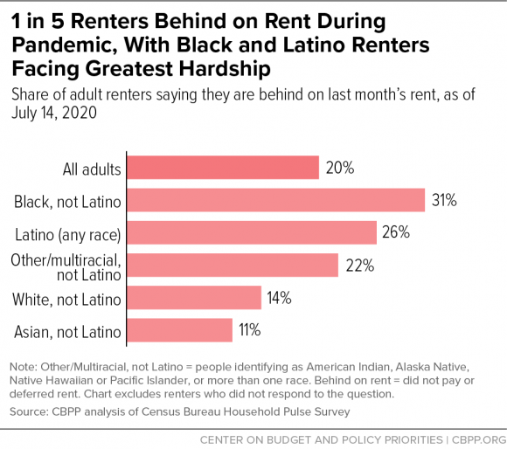
Racial Implications of the Crisis
Notes:
The eviction statistice have clear implications for race equity. Minority communities have been more heavily impacted by COVID. They were both disproportionately considered essential workers and, at the same time, are over represented in the service industry. There is a long history documenting the bad health outcomes in minority communities. As a result, minority groups have suffered more both by getting sicker and loosing jobs at higher numbers. Therefore, it is no surprise that the eviction numbers are higher for these populations

Slide 16
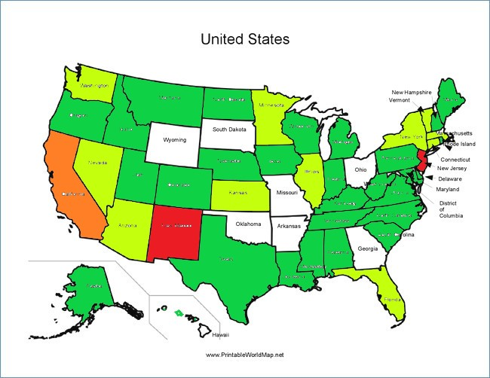
State Moratorium
White: no orders
Green: previous, but expired
Lt. Green: expiring in Oct.
Orange: expiring in 2021
Red: open ended
Notes:
As mentioned earlier, many states did enact moratoria on evictions.
Explain the map

Slide 17
GRANTS TO STATES AND LOCALITIES TO PROVIDE RENTAL, UTILITY AND MORTGAGE ASSISTANCE
HUD 1.9 Billion in CARES ACT GRANTS
Notes:
Hud has provide 1.9 billion in cares act funding grant. The grants are available for people who have fallen behind on their rents. It provided up to 3 months rental payments for qualifying tenants. The problem is that the money was used very fast, in some states it was exhausted in days. Millions of people are still unable to pay their rent (estimates of between 1/3 and 40% of all renters).

Slide 18
Federal
HUD: all FHA insured
FHFA: properties with GSE loans
CDC: limited to certain renters
Extended to the end of the year
Notes:
Currently, whether you can be evicted depends on a number of factors. In most states, you can be evicted for lease violations or if your lease has ended. Nonpayment are evictions are stayed in a number of situations.
The agencies involved in federally related mortages have extended their moratoria until the end of the year
The cdc issued its own moratoria with more limited protections

Slide 19
CDC Moratorium
Must sign a declaration that:
Reduction in Income due to job loss, reduced hours or medical expenses
Have applied for financial aid
Making best effort to pay what you can
Will be homeless if evicted
Income is less than $99,000 ($198,000 for couples)
No eviction till Dec. 31
Notes:
Go over this

Slide 20
Rationalle
Medical
Legal
Census data that 32% of those evicted move in with family or friends
Shelters could not physically distance the number of people involved
Data showed 9% of shelter residents positive
30-40 million at risk for eviction
State efforts insufficient to prevent spread 42 CFR §70.2
Claims Administrative Procedure Act notice and comment rules do not apply
OR
5 USC §553 (b)(3)(B): has good cause to avoid notice and comment
Notes:
Explain the medical and legal rationale for this

Slide 21
Challenges files
Violation of Administrative Procedures Act
Violation of Access to Courts
Violation of Supremacy Clause
Notes:
Briefly discuss the challenges

